Slide 1


ALL ACCESS Based on E-Commerce

Slide 2
PRESENTED BY:
AKANKSHA CHOURASIA(51964748)
KIRTI SHEKHAR PANDEY(51964753)
SHUBHI SINGH(51964783)
UTSAV PATERIYA(51964753)

Slide 3
OUTLINE:
What is All Access?
Project Objectives
Some Important Goals
DFD Diagrams
Languages & Tools
Screenshots
Advantages
Disadvantages
Future Scope
References

Slide 4
What is ALL ACCESS?
Basically All Access is based on e-commerce.
All Access mainly focuses on basic operations adding new buyer , new seller and products.
It has three main module:
Buyer
Seller
Admin

Slide 5
Project Objective:
The key objectives to support the aims are:
The objective of the Shopping systems is to increase the point of customer choice.
Reduce time used in shopping.
Efficiency in buying product

Slide 6
Some Important Goals:
Catch more customer.
Increase the traffic.
Make more sale.
Best customer service.
Minimum Shipping time.
Increase the number of reviews.
Get Positive feedback. 
Customer follow up.

Slide 7
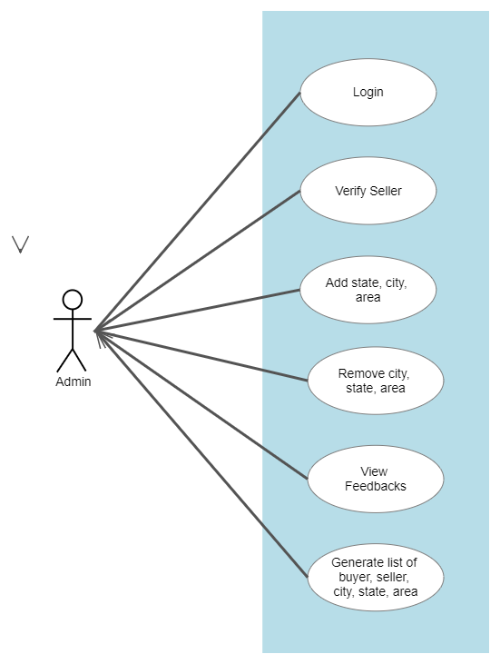
Admin Flowchart :

Slide 8
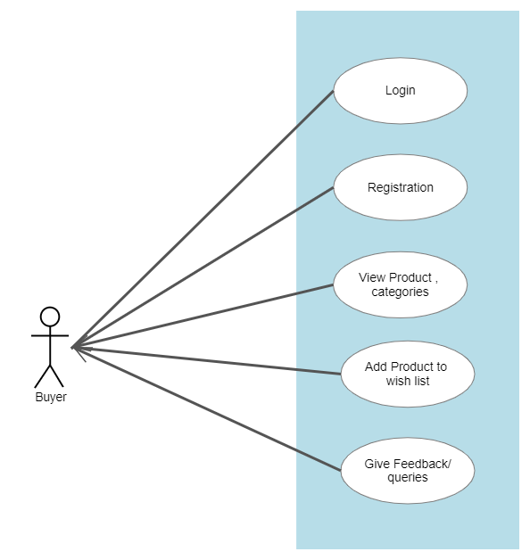
Byer Flowchart:

Slide 9
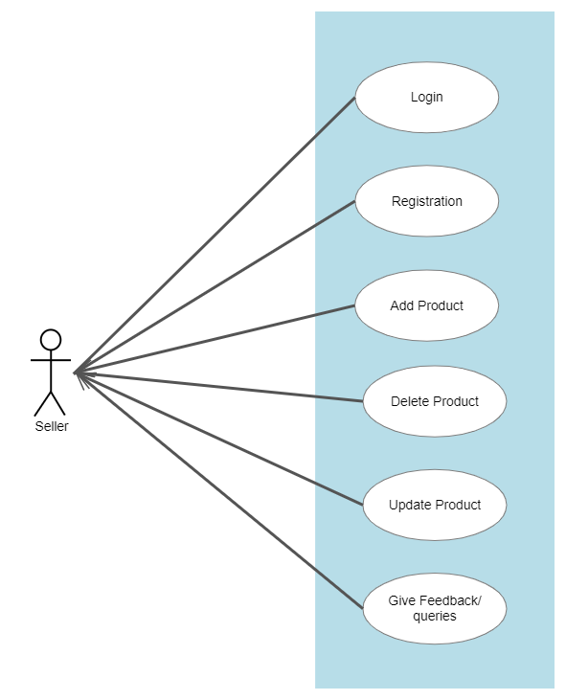
Seller Flowchart:

Slide 10
Languages & Tools:
Tools:
Eclipse
Postman
Languages:
HTML
CSS
JavaScript
Java
Spring Framework
Data JPA
Junit Testing
Oracle
JSP

Slide 11
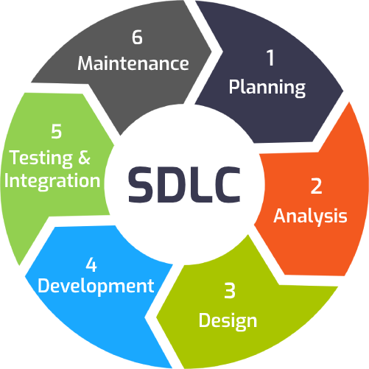

Slide 12
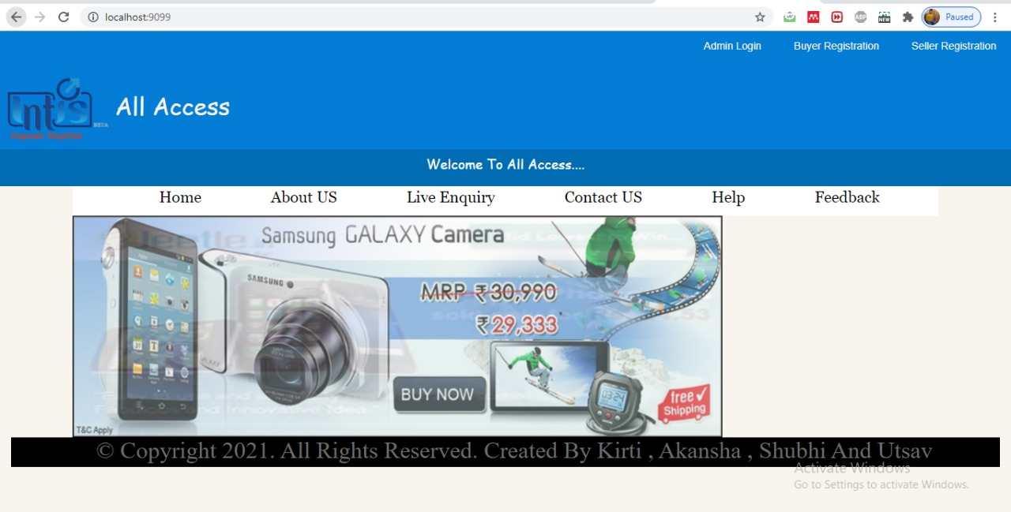
Screenshots:

Slide 13
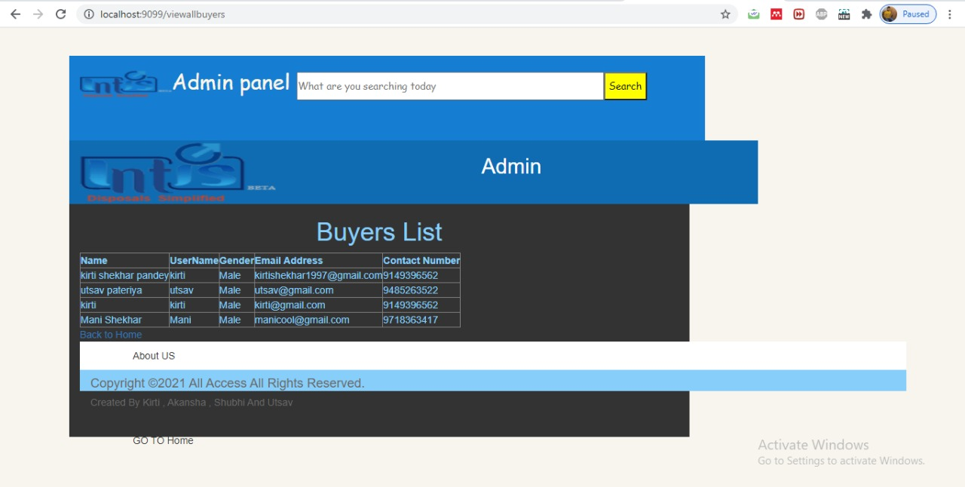

Slide 14
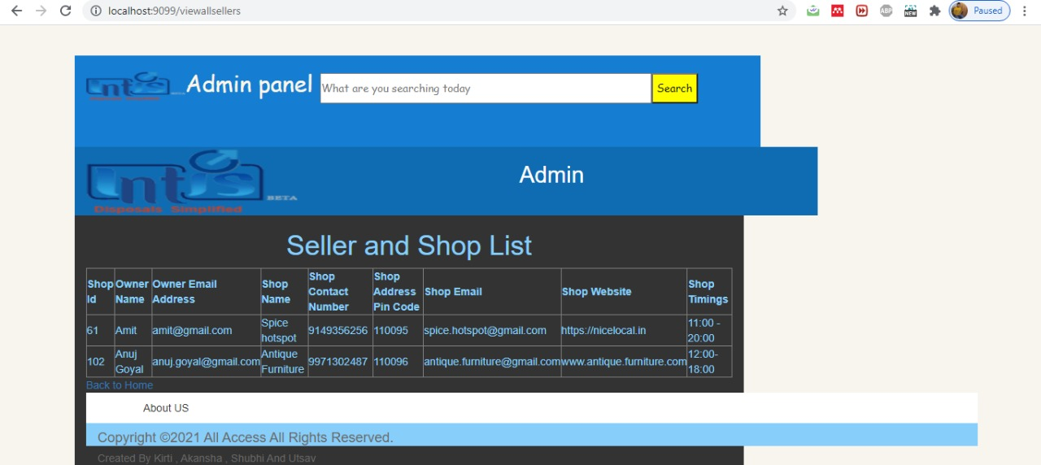

Slide 15
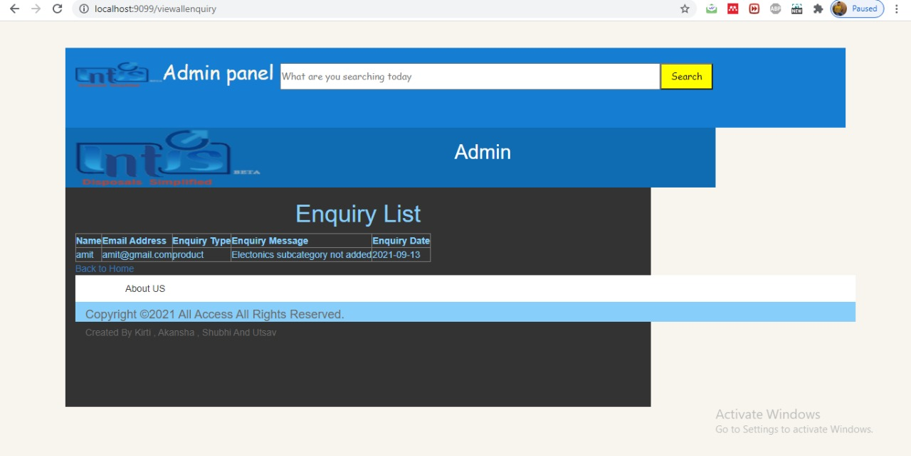

Slide 16
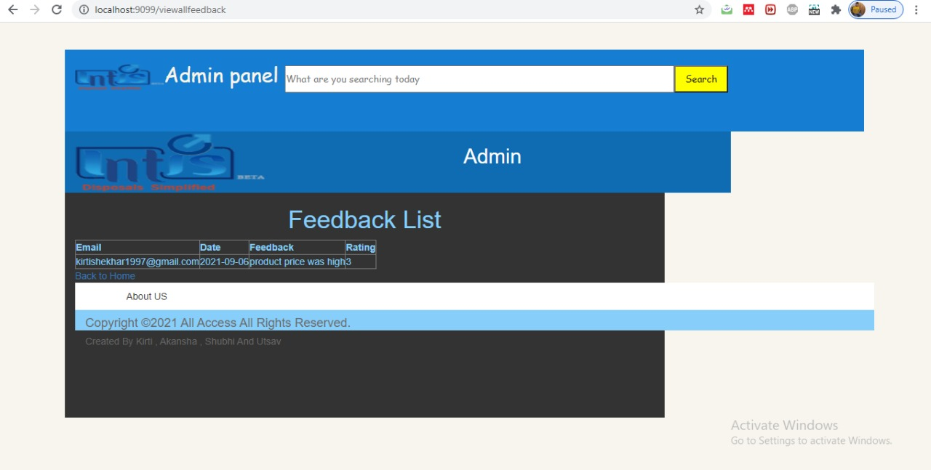

Slide 17
Advantages
Faster buying/selling procedure, as well as easy to find products.
Buying/selling 24/7.
More reach to customers, there is no theoretical geographic limitations.
Low operational costs and better quality of services. 
No need of physical company set-ups. 
Easy to start and manage a business.

Slide 18
Disadvantages
Unable to examine products personally.
Not everyone is connected to the Internet.
The login of the user involves the login through database.
Many necessary features are not available now for both user and admin.

Slide 19
Future Scope
We are thinking of some modifications and adding some advanced new features in our project:
GUI modification (more user friendly).
Users can signup / login using their social media account such as face.
Add more feature in admin panel.
Users can sell their products.
The scope of this project is only limited to few states. In future we are planning to increase its scope all over India.
Add payment Gateway.

Slide 20
References
http://www.w3schools.com
http://www.javatpoint.com
http://www.tutorialspoint.com
http://www.tektutorialshub.com
http://www.geekforgeeks.com
Http://www.coderanch.com
Http://www.stackoverflow.com

Slide 21


Slide 22


